Slide 1
Lecture
Equity Financing
12
L.O. 11-1: Corporate form of organization
L.O. 11-2: Accounting for stock issuances
L.O. 11-3: Dividends and stock splits
L.O. 11-4: Reporting and analyzing stockholders’ equity

Slide 2
Learning Objective 11-1
Corporate Form of Organization

Slide 3
Outline
The corporation and its characteristics
Forming a corporation
Stockholder rights
Stock issue considerations
Corporate Capital

Slide 4
Corporation
An entity separate and distinct from its owners.
Classified by Purpose
Not-for-Profit
For Profit
Classified by Ownership
Publicly held
Privately held
Salvation Army
American Cancer Society
McDonald’s
Nike
PepsiCo
Google
Cargill Inc.

Slide 5
Characteristics of a Corporation
Characteristics that distinguish corporations from proprietorships and partnerships.
Separate Legal Existence
Limited Liability of Stockholders
Transferable Ownership Rights
Ability to Acquire Capital
Continuous Life
Corporate Management
Government Regulations
Additional Taxes
Advantages
Disadvantages

Slide 6
Characteristics of a Corporation
Characteristics that distinguish corporations from proprietorships and partnerships.
Corporation acts under its own name rather than in the name of its stockholders.
Separate Legal Existence
Limited Liability of Stockholders
Transferable Ownership Rights
Ability to Acquire Capital
Continuous Life
Corporate Management
Government Regulations
Additional Taxes

Slide 7
Characteristics of a Corporation
Characteristics that distinguish corporations from proprietorships and partnerships.
Separate Legal Existence
Limited Liability of Stockholders
Transferable Ownership Rights
Ability to Acquire Capital
Continuous Life
Corporate Management
Government Regulations
Additional Taxes
Limited to their investment.

Slide 8
Characteristics of a Corporation
Characteristics that distinguish corporations from proprietorships and partnerships.
Separate Legal Existence
Limited Liability of Stockholders
Transferable Ownership Rights
Ability to Acquire Capital
Continuous Life
Corporate Management
Government Regulations
Additional Taxes
Shareholders may sell their stock.

Slide 9
Characteristics of a Corporation
Characteristics that distinguish corporations from proprietorships and partnerships.
Separate Legal Existence
Limited Liability of Stockholders
Transferable Ownership Rights
Ability to Acquire Capital
Continuous Life
Corporate Management
Government Regulations
Additional Taxes
Corporation can obtain capital through the issuance of stock.

Slide 10
Characteristics of a Corporation
Characteristics that distinguish corporations from proprietorships and partnerships.
Separate Legal Existence
Limited Liability of Stockholders
Transferable Ownership Rights
Ability to Acquire Capital
Continuous Life
Corporate Management
Government Regulations
Additional Taxes
Continuance as a going concern is not affected by the withdrawal, death, or incapacity of a stockholder, employee, or officer.

Slide 11
Characteristics of a Corporation
Characteristics that distinguish corporations from proprietorships and partnerships.
Separate Legal Existence
Limited Liability of Stockholders
Transferable Ownership Rights
Ability to Acquire Capital
Continuous Life
Corporate Management
Government Regulations
Additional Taxes
Separation of ownership and management often reduces an owner’s ability to actively manage the company.

Slide 12
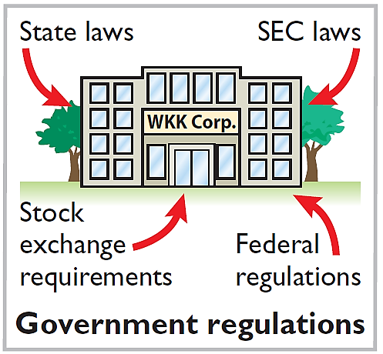
Characteristics of a Corporation
Characteristics that distinguish corporations from proprietorships and partnerships.
Separate Legal Existence
Limited Liability of Stockholders
Transferable Ownership Rights
Ability to Acquire Capital
Continuous Life
Corporate Management
Government Regulations
Additional Taxes

Slide 13
Characteristics of a Corporation
Characteristics that distinguish corporations from proprietorships and partnerships.
Separate Legal Existence
Limited Liability of Stockholders
Transferable Ownership Rights
Ability to Acquire Capital
Continuous Life
Corporate Management
Government Regulations
Additional Taxes
Corporations pay income taxes as a separate legal entity and in addition, stockholders pay taxes on cash dividends.

Slide 14
Forming a Corporation
Initial Steps:
File application with the Secretary of State.
State grants charter.
Corporation develops by-laws.
Alternative Terminology
The charter is often
referred to as the articles
of incorporation.
Companies generally incorporate in a state whose laws are favorable to the corporate form of business (Delaware, New Jersey).
Corporations engaged in interstate commerce must obtain a license from each state in which they do business.

Slide 15

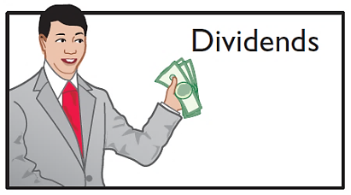
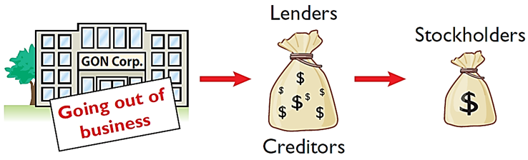
Stockholder Rights
1. Vote in election of board of directors and on actions that require stockholder approval.
2. Share the corporate earnings through receipt of dividends.
3. Keep the same percentage ownership when new shares of stock are issued (preemptive right).
4. Share in assets upon liquidation in proportion to their holdings. This is called a residual claim.

Slide 16
Stock Issue Considerations
When a corporation decides to issue stock, it must resolve a number of basic questions:
How many shares should it authorize for sale?
How should it issue the stock?
What value should the corporation assign to the stock?

Slide 17
Stock Issue Considerations
AUTHORIZED STOCK
Charter indicates the amount of stock that a corporation is authorized to sell.
Number of authorized shares is often reported in the stockholders’ equity section.
No formal accounting entry.

Slide 18

Stock Issue Considerations
Prenumbered
Shares
Illustration 11-4
Name of corporation
Stockholder’s name
Signature of corporate official

Slide 19
Stock Issue Considerations
ISSUANCE OF STOCK
Companies issue common stock directly to investors or indirectly through an investment banking firm.
Factors in setting price for a new issue of stock:
Company’s anticipated future earnings.
Expected dividend rate per share.
Current financial position.
Current state of the economy.
Current state of the securities market.

Slide 20
Stock Issue Considerations
MARKET PRICE OF STOCK
Stock of publicly held companies is traded on organized exchanges.
Interaction between buyers and sellers determines the prices per share.
Prices tend to follow the trend of a company’s earnings and dividends.
Factors beyond a company’s control may cause day-to-day fluctuations in market prices.

Slide 21
Corporate Capital
Common Stock
Account
Paid-in Capital
Preferred Stock
Account
Two Primary Sources of Equity
Retained Earnings
Account
Paid-in capital is the total amount of cash and other assets paid in to the corporation by stockholders in exchange for capital stock.
Retained earnings is net income that a corporation retains for future use.

Slide 22
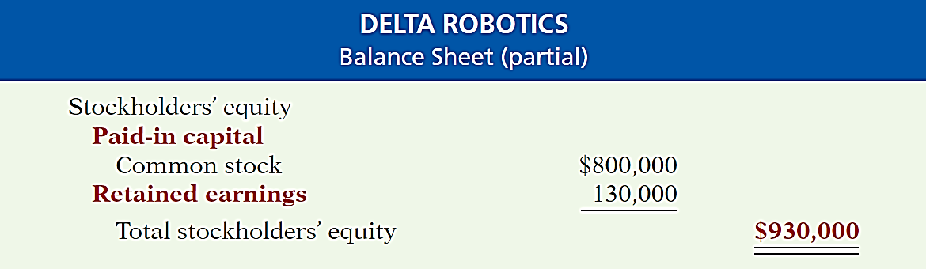
Corporate Capital
If Delta Robotics has a balance of $800,000 in common stock and $130,000 in retained earnings at the end of its first year, its stockholders’ equity section is as follows.

Slide 23
Learnings Objective 11-2
Accounting for stock issuances

Slide 24
Outline
Accounting for common stock
Accounting for preferred stock
Accounting for treasury stock

Slide 25
Accounting for Common Stock
Issuing Par Value Common Stock for Cash
Illustration: Assume that Hydro-Slide, Inc. issues 1,000 shares of $1 par value common stock. Prepare Hydro-Slide’s journal entry if (a) 1,000 share are issued for $1 per share, and (b) 1,000 shares are issued for $5 per share.
a.
Cash
1,000
Common Stock (1,000 × $1)
1,000
b.
Cash
5,000
Common Stock (1,000 × $1)
1,000
Paid-in Capital in Excess of Par Value – Common Stock
4,000

Slide 26
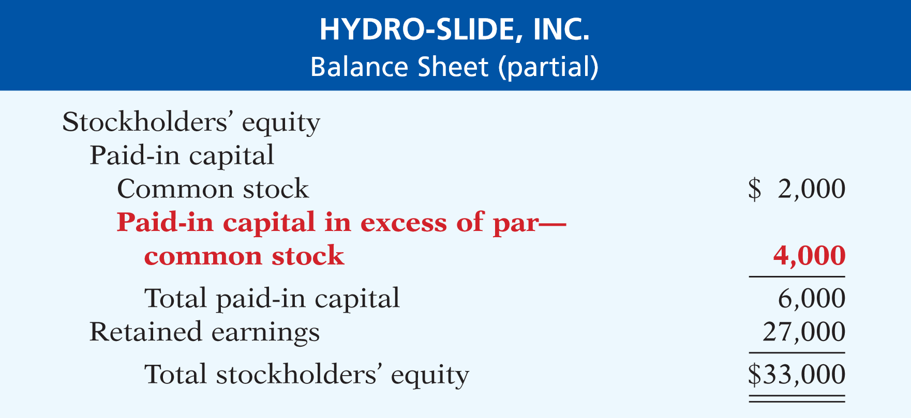
Accounting for Common Stock
Example
Alternative Terminology
Paid-in Capital in Excess of Par is also called Premium on Stock.

Slide 27
Accounting for Common Stock
Issuing No-par Common Stock for Cash
With Stated Value
Illustration: Assume that instead of $1 par value stock, Hydro-Slide, Inc. has $5 stated value no-par stock and the company issues 5,000 shares at $8 per share for cash.
Cash
40,000
Common Stock
25,000
Paid-in Capital in Excess of Stated Value
15,000

Slide 28
Accounting for Common Stock
Issuing No-par Common Stock for Cash
Without Stated Value
Illustration: What happens when no-par stock does not have a stated value?
Cash
40,000
Common Stock
40,000

Slide 29
Accounting for Common Stock
Issuing Common Stock for Services or Noncash Assets
Corporations also may issue stock for:
Services (attorneys or consultants).
Noncash assets (land, buildings, and equipment).
Cost is either the fair market value of the consideration given up, or the fair market value of the consideration received, whichever is more clearly determinable.

Slide 30
Common Stock For Services
Illustration: Attorneys have helped Jordan Company incorporate. They have billed the company $5,000 for their services. They agree to accept 4,000 shares of $1 par value common stock in payment of their bill. At the time of the exchange, there is no established market price for the stock. Prepare the journal entry for this transaction.
Organization Expense
5,000
Common Stock (4,000 × $1)
4,000
Paid-in Capital in Excess of Par
1,000

Slide 31
Common Stock For Noncash Asset
Illustration: Athletic Research Inc. is an existing publicly held corporation. Its $5 par value stock is actively traded at $8 per share. The company issues 10,000 shares of stock to acquire land recently advertised for sale at $90,000. Prepare the journal entry for this transaction.
Land
80,000
Common Stock (10,000 × $5)
50,000
Paid-in Capital in Excess of Par
30,000

Slide 32
Accounting For Preferred Stock
Typically, preferred stockholders have a priority as to:
Distributions of earnings (dividends).
Assets in event of liquidation.
Generally do not have voting rights.
Accounting for preferred stock at issuance is similar to that for common stock.

Slide 33
Accounting For Preferred Stock
Illustration: Stine Corporation issues 10,000 shares of $10 par value preferred stock for $12 cash per share. The journal entry to record the issuance is:
Cash
120,000
Preferred Stock (10,000 × $10)
100,000
Paid-in Capital in Excess of Par
20,000
Preferred stock may have a par value or no-par value.

Slide 34
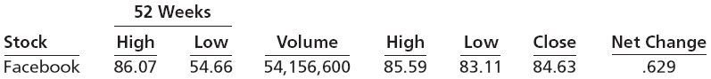
Investor Insight Facebook
How to Read Stock Quotes
These numbers indicate the following.
The high and low market prices for the last 52 weeks have been $86.07 and $54.66.
The trading volume for the day was 54,156,600 shares.
The high, low, and closing prices for that date were $85.59, $83.11, and $84.63, respectively.
The net change for the day was an increase of $0.629 per share.

Slide 35
Do It! 2a: Issuance of Stock
March 1 Entry
Cayman Corporation begins operations on March 1 by issuing 100,000 shares of $1 par value common stock for cash at $12 per share. Journalize the issuance of the shares.
Mar. 1
Cash
1,200,000
Common Stock (100,000 × $1)
100,000
Paid-in Capital in Excess of Par Value — Common Stock
1,100,000

Slide 36
Do It! 2a: Issuance of Stock
March 15 Entry
On March 15, it issues 5,000 shares of common stock to attorneys in settlement of their bill of $50,000 for organization costs.
Mar. 15
Organizational Expense
50,000
Common Stock (5,000 × $1)
5,000
Paid-in Capital in Excess of Par Value — Common Stock
45,000

Slide 37
Do It! 2a: Issuance of Stock
March 28 Entry
On March 28, Cayman Corporation issues 1,500 shares of $10 par value preferred stock for cash at $30 per share.
Mar. 28
Cash
45,000
Preferred Stock (1,500 × $10)
15,000
Paid-in Capital in Excess of Par Value — Preferred Stock
30,000

Slide 38
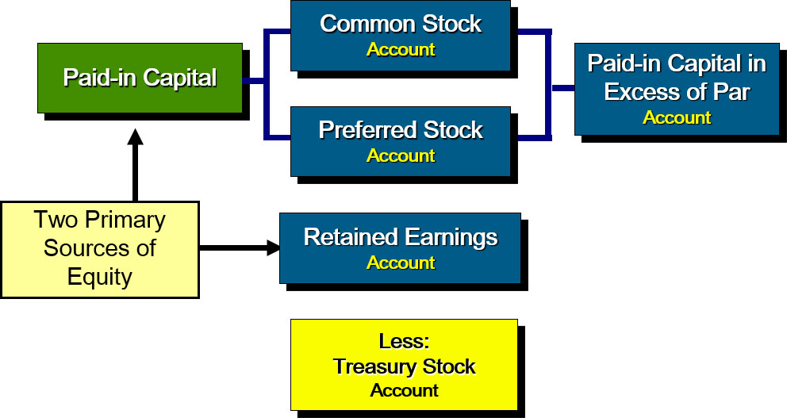
Accounting for Treasury Stock
Contra Equity Account

Slide 39
Accounting for Treasury Stock
Reasons to Acquire Treasury Stock
Treasury stock is a corporation’s own stock that it has reacquired from shareholders that hasn’t been retired.
Corporations acquire treasury stock for various reasons:
To reissue the shares to officers and employees under bonus and stock compensation plans.
To enhance the stock’s market value.
To have additional shares available for use in the acquisition of other companies.
To increase earnings per share.

Slide 40
Accounting for Treasury Stock
Purchase of Treasury Stock
Companies generally use the cost method.
Debit Treasury Stock for the price paid to reacquire the shares.
Treasury stock is a contra stockholders’ equity account. Reduces stockholders’ equity.
Helpful Hint
Treasury shares do not have dividend rights or voting rights.

Slide 41
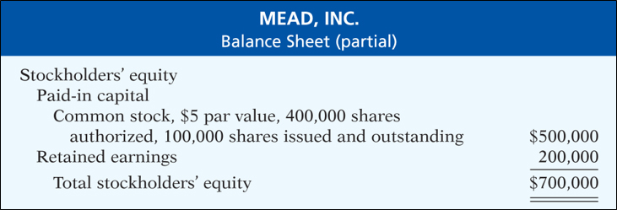
Purchase Of Treasury Stock
Journal Entry to Acquire Treasury Stock
Illustration: On February 1, 2019, Mead acquires 4,000 shares of its stock at $8 per share.
Treasury Stock (4,000 × $8)
32,000
Cash
32,000

Slide 42
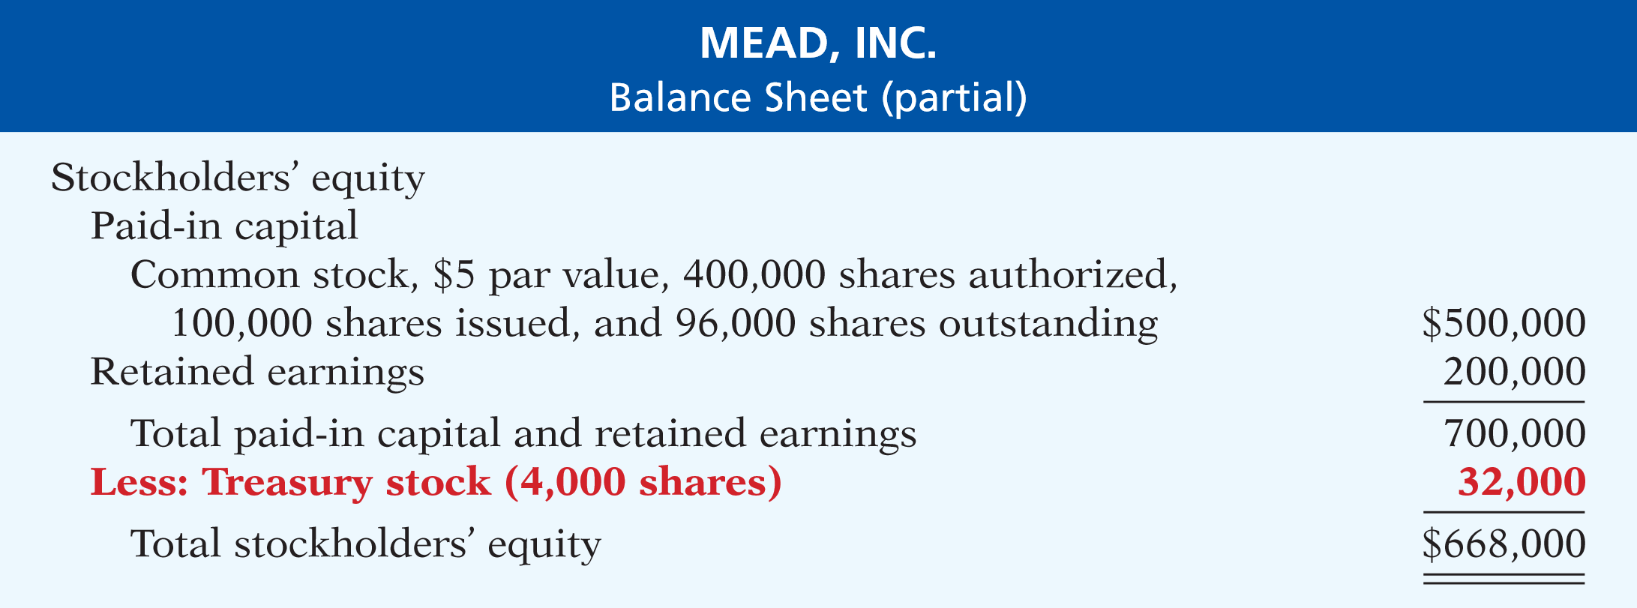
Purchase Of Treasury Stock
Presentation on Balance Sheet
Both the number of shares issued (100,000) and the number of shares held as treasury (4,000) are disclosed.

Slide 43
Disposal Of Treasury Stock
Sale of Treasury Stock
Above Cost
Below Cost
Both increase total assets and stockholders’ equity.
Helpful Hint
Treasury stock transactions are classified as capital stock transactions. As in the case when stock is issued, the income statement is not involved.

Slide 44
Sale of Treasury Stock “Above” Cost
Illustration: On July 1, Mead sells for $10 per share 1,000 shares of its treasury stock previously acquired at $8 per share and makes the following entry.
Cash
10,000
Treasury Stock
8,000
Paid-in Capital from Treasury Stock
2,000
A corporation does not realize a gain or suffer a loss from stock transactions with its own stockholders.

Slide 45
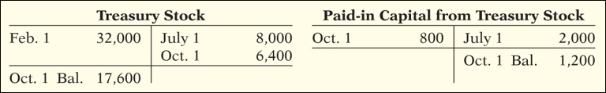
Sale of Treasury Stock “Below” Cost
Illustration: On Oct. 1, Mead sells an additional 800 shares of treasury stock at $7 per share and makes the following entry.
Cash
5,600
Paid-in Capital from Treasury Stock
800
Treasury Stock
6,400

Slide 46
Sale of Treasury Stock “Below” Cost
May Need to Debit Retained Earnings
Illustration: On Dec. 1, assume that Mead, Inc. sells its remaining 2,200 shares at $7 per share and makes the following entry.
Cash
15,400
Paid-in Capital from Treasury Stock
1,200
Limited to balance on hand
Retained Earnings
1,000
Treasury Stock
17,600

Slide 47
Do It! 2b: Treasury Stock
Santa Anita Inc. purchases 3,000 shares of its $50 par value common stock for $180,000 cash on July 1. Journalize the treasury stock transactions.
July 1
Treasury Stock
180,000
Cash
180,000
On November 1, the corporation sells 1,000 shares of treasury stock for cash at $70 per share.
Nov. 1
Cash
70,000
Treasury Stock
60,000
Paid-in Capital from Treasury Stock
10,000

Slide 48
Learning Objective 11-3
Dividends and Stock Splits

Slide 49
Outline
Cash dividends
Dividend preferences
Stock dividends
Stock splits

Slide 50
Dividends
Distribution of cash or stock to stockholders on a pro rata (proportional to ownership) basis.
Types of Dividends:
Cash dividends.
Property dividends.
Stock dividends.
Scrip (promissory note).
Dividends are generally reported quarterly as a dollar amount per share.

Slide 51
Cash Dividends
Three Items Needed
For a corporation to pay a cash dividend, it must have:
Retained earnings - Payment of cash dividends from retained earnings is legal in all states.
Adequate cash.
A declaration of dividends by the Board of Directors.

Slide 52
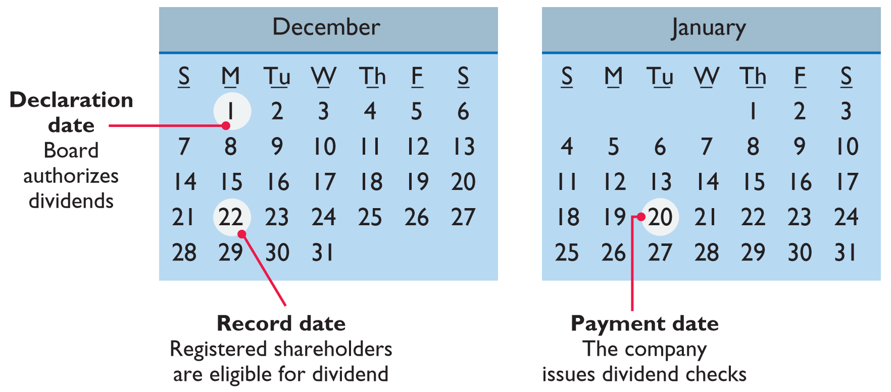
Cash Dividends
Three Important Dates

Slide 53
Cash Dividends
Journal Entries
Illustration: On Dec. 1, the directors of Media General declare a 50 cents per share cash dividend on 100,000 shares of $10 par value common stock. The dividend is payable on Jan. 20 to shareholders of record on Dec. 22.
Dec. 1 (Declaration Date) end underline
Cash Dividends
50,000
Dividends Payable
50,000
Dec. 22 (Date of Record) end underline
No entry
Jan. 20 (Payment Date) end underline
Dividends Payable
50,000
Cash
50,000

Slide 54
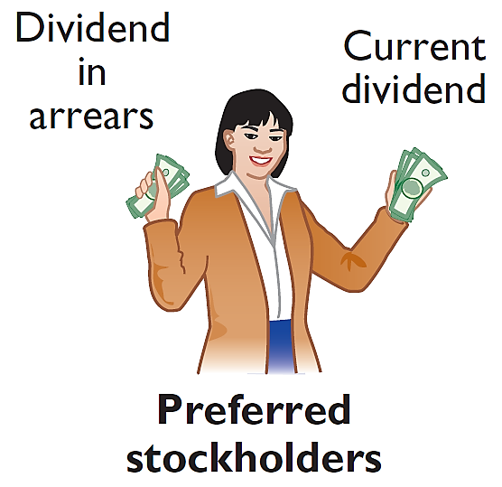
Dividend Preferences
Cumulative Dividend on Preferred Stock
Right to receive dividends before common stockholders.
Per share dividend amount is stated as a percentage of the preferred stock’s par value or as a specified amount.
Cumulative Preferred stockholders must be paid both current-year dividends and any unpaid prior-year dividends before common stockholders receive dividends.

Slide 55
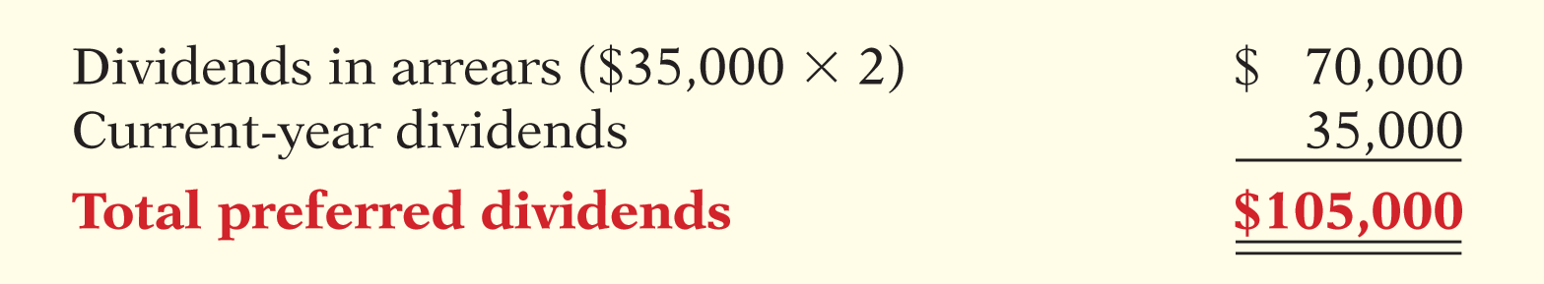
Dividend Preferences
Calculation of Cumulative Preferred Dividends
Illustration: Scientific Leasing has 5,000 shares of 7%, $100 par value, cumulative preferred stock outstanding. Each $100 share pays a $7 dividend (.07 × $100). The annual dividend is $35,000 (5,000 × $7 per share). If dividends are two years in arrears, preferred stockholders are entitled to receive the following dividends in the current year.

Slide 56
Allocating Cash Dividends
Declaration of $6,000 Dividend on Dec. 31, 2019
Illustration: On December 31, 2019, IBR Inc. has 1,000 shares of 8%, $100 par value cumulative preferred stock. It also has 50,000 shares of $10 par value common stock outstanding. On December 31, 2019, the directors declare a $6,000 cash dividend. Prepare the entry to record the declaration of the dividend.
Cash Dividends
6,000
Dividends Payable
6,000
Preferred Dividends: 1,000 shares × $100 par × 8% = $8,000

Slide 57
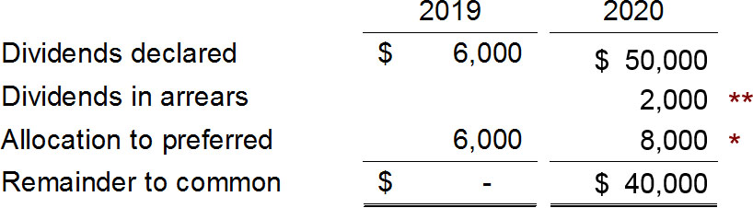
Allocating Cash Dividends
Declaration of $50,000 Dividend on Dec. 31, 2020
Illustration: On December 31, 2020, IBR declares a $50,000 cash dividend. Show the allocation of dividends to each class of stock.
* 1,000 shares × $100 par × 8% = $8,000
** 2019 Pfd. dividends $8,000 – declared $6,000 = $2,000

Slide 58
Allocating Cash Dividends
Journal Entry to Record Declaration of Dividends
Illustration: At December 31, 2020, IBR declares a $50,000 cash dividend. Prepare the entry to record the declaration of the dividend.
Cash Dividends
50,000
Dividends Payable
50,000

Slide 59
Do It! 3a: Dividends on Preferred and Common Stock
MasterMind Corporation has 2,000 shares of 6%, $100 par value preferred stock outstanding at December 31, 2019. At December 31, 2019, the company declared a $60,000 cash dividend. Determine the dividend paid to preferred stockholders and common stockholders under each of the following scenarios.
1. The preferred stock is noncumulative, and the company has not missed any dividends in previous years.
Solution
Preferred stockholders are paid only this year’s dividend.
Preferred stockholders = $12,000 (2,000 × .06 × $100).
Common stockholders = $48,000 ($60,000 − $12,000).

Slide 60
Do It! 3a: Dividends on Preferred and Common Stock
MasterMind Corporation has 2,000 shares of 6%, $100 par value preferred stock outstanding at December 31, 2019. At December 31, 2019, the company declared a $60,000 cash dividend. Determine the dividend paid to preferred stockholders and common stockholders under each of the following scenarios.
2. The preferred stock is noncumulative, and the company did not pay a dividend in each of the two previous years.
Solution
Past unpaid dividends do not have to be paid.
Preferred stockholders = $12,000 (2,000 × .06 × $100).
Common stockholders = $48,000 ($60,000 − $12,000).

Slide 61
Do It! 3a: Dividends on Preferred and Common Stock
MasterMind Corporation has 2,000 shares of 6%, $100 par value preferred stock outstanding at December 31, 2019. At December 31, 2019, the company declared a $60,000 cash dividend. Determine the dividend paid to preferred stockholders and common stockholders under each of the following scenarios.
3. The preferred stock is cumulative, and the company did not pay a dividend in each of the two previous years.
Solution
Dividends that have been missed (dividends in arrears) must be paid.
Preferred stockholders = $36,000 (3 × 2,000 × .06 × $100).
Common stockholders = $24,000 ($60,000 − $36,000).

Slide 62
Stock Dividends
Reasons to Issue Stock Dividends
A pro rata (proportional to ownership) distribution of the corporation’s own stock to stockholders.
Reasons why corporations issue stock dividends:
Satisfy stockholders’ dividend expectations without spending cash.
Increase marketability of the corporation’s stock.
Emphasize a portion of stockholders’ equity has been permanently reinvested in the business.

Slide 63
Stock Dividends
Small Stock Dividends and Large Stock Dividends
Small stock dividend (less than 20–25% of the corporation’s issued stock, recorded at fair market value)
– Small stock dividend dominants in practice
Large stock dividend (greater than 20–25% of issued stock, recorded at par value)
* Accounting based on the assumption that a small stock dividend will have little effect on the market price of the outstanding shares.

Slide 64
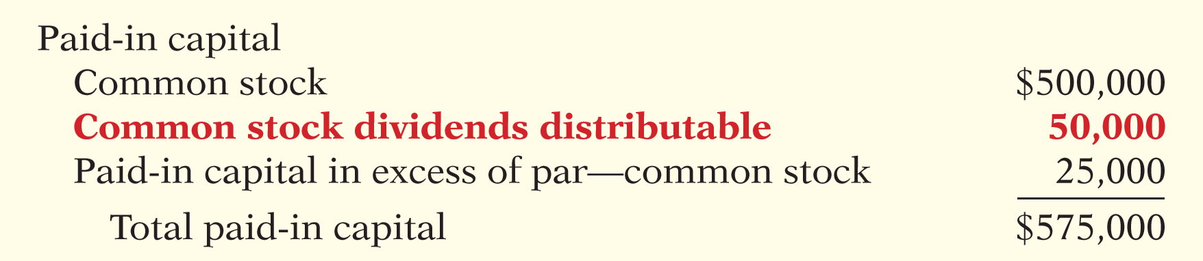
Entry to Declare a Stock Dividend
Illustration: Medland Corporation declares a 10% stock dividend on its 50,000 shares of $10 par value common stock. The current fair market value of its stock is $15 per share. Record the entry on the declaration date:
Stock Dividends (50,000 × 10% × $15)
75,000
Common Stock Dividends Distributable
50,000
Paid-in Capital in Excess of Par—Common Stock
25,000

Slide 65
Stock Dividends
Entries to Declare and Pay a Stock Dividend
Illustration: Medland Corporation declares a 10% stock dividend on its 50,000 shares of $10 par value common stock. The current fair market value of its stock is $15 per share. Record the entry on the declaration date:
Stock Dividends (50,000 × 10% × $15)
75,000
Common Stock Dividends Distributable
50,000
Paid-in Capital in Excess of Par—Common Stock
25,000
Record the journal entry when Medland issues the dividend shares.
Common Stock Dividends Distributable
50,000
Common Stock
50,000

Slide 66
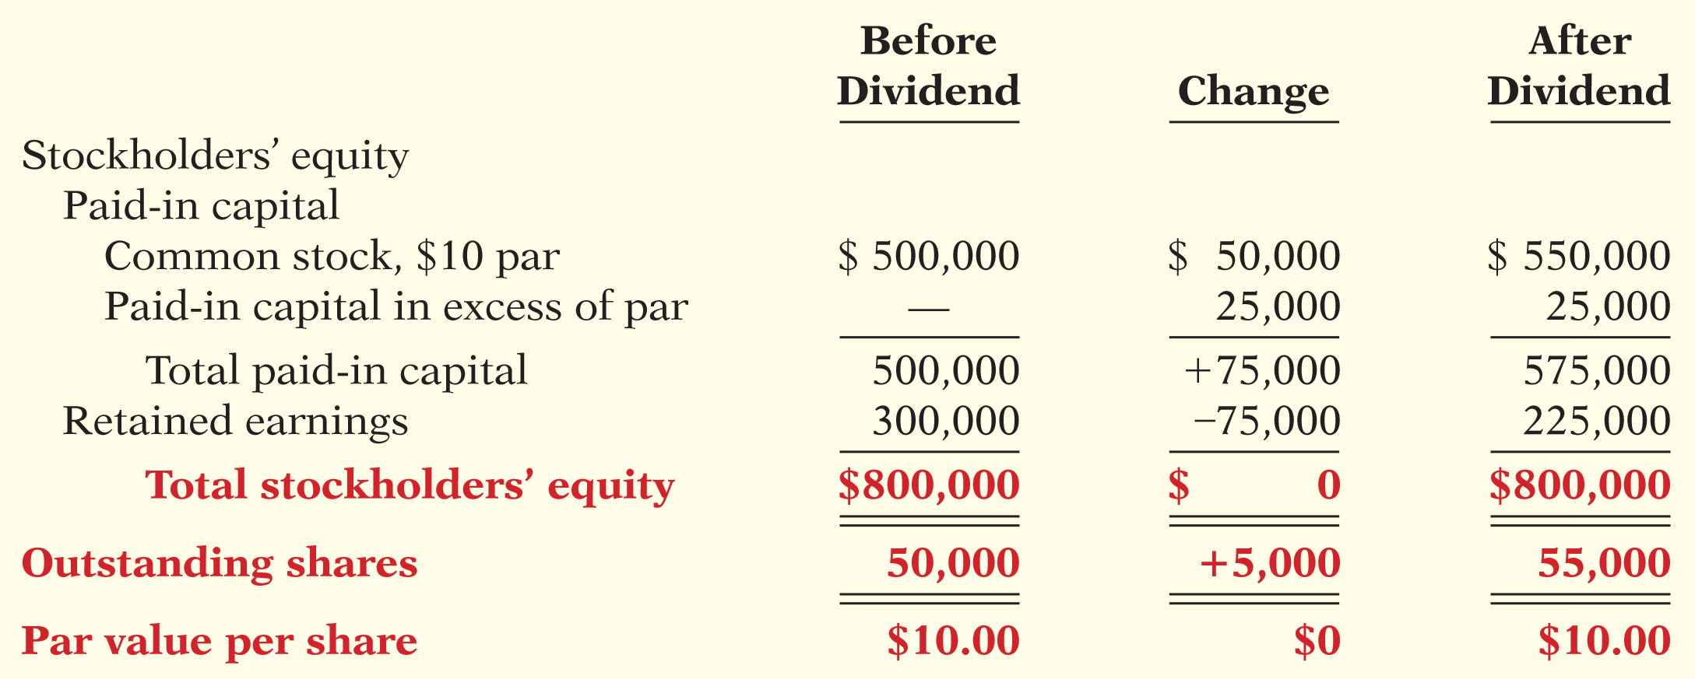
Stock Dividends
Effects of Stock Dividends

Slide 67
Stock Dividends
Small Stock Dividends Question
Which of the following statements about small stock dividends is true?
a. A debit to Stock Dividends for the par value of the shares issued should be made.
b. A small stock dividend decreases total stockholders’ equity.
c. Market value per share should be assigned to the dividend shares.
d. A small stock dividend ordinarily will have an effect on par value per share of stock.

Slide 68
Stock Dividends
Common Stock Dividends Distributable Question
In the stockholders’ equity section, Common Stock Dividends Distributable is reported as a(n):
a. deduction from total paid-in capital and retained earnings.
b. current liability.
c. deduction from retained earnings.
d. addition to capital stock.

Slide 69
Stock Splits
Issuance of additional shares to stockholders according to their percentage ownership.
Reduction in the par or stated value per share.
Increase in number of shares outstanding.
Reduces the market value per share.
No journal entry recorded.
Helpful Hint
A stock split changes the par value per share but does not affect any balances in stockholders’ equity.

Slide 70
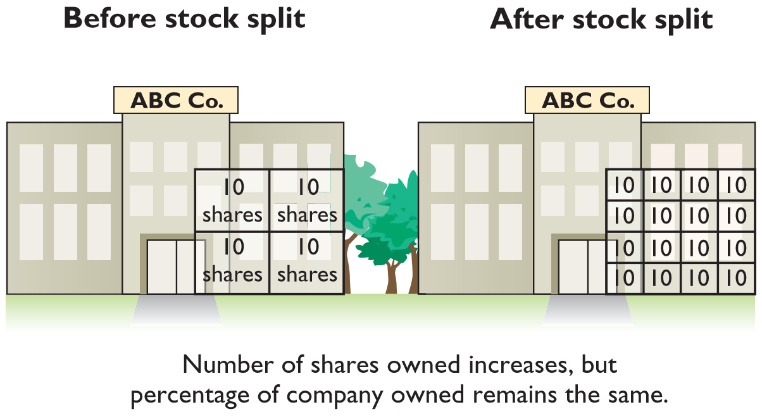
Stock Splits
Effect of 4-for-1 Stock Split for Stockholders

Slide 71
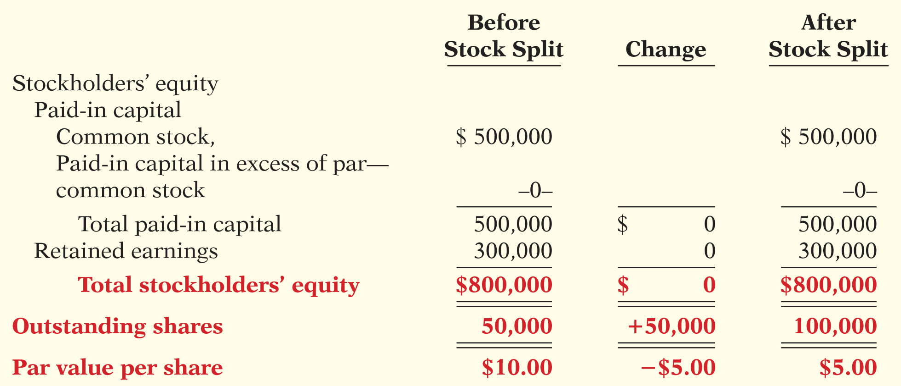
Stock Splits
Stockholders’ Equity Before and After Stock Split
Effects for Medland Corporation, assuming that it splits its 50,000 shares of common stock on a 2-for-1 basis.

Slide 72
Do It! 3b: Stock Dividends and Stock Splits
Sing CD Company has had five years of record earnings. Due to this success, the market price of its 500,000 shares of $2 par value common stock has tripled from $15 per share to $45. President Joan Elbert is considering either a 10% stock dividend or a 2-for-1 stock split. She asks you to show the before-and-after effects.
(Paid-in capital is $2,000,000. Retained earnings is $10,000,000. )
 | Original Balances | After Dividend | After Split
Paid-in Capital
Common stock, $2 par | $ 1,000,000 | $ 1,100,000 | $ 1,000,000
Paid-in Capital in excess of par - common stock | 1,000,000 | 3,150,000 | 1,000,000
Total paid-in capital | 2,000,000 | 4,250,000 | 2,000,000
Retained earnings | 10,000,000 | 7,750,000 | 10,000,000
Total stockholders' equity | $ 12,000,000 | $ 12,000,000 | $ 12,000,000
Outstanding shares | 500,000 | 550,000 | 1,000,000
Par value per share | $ 2.00 | $ 2.00 | $ 1.00

Slide 73
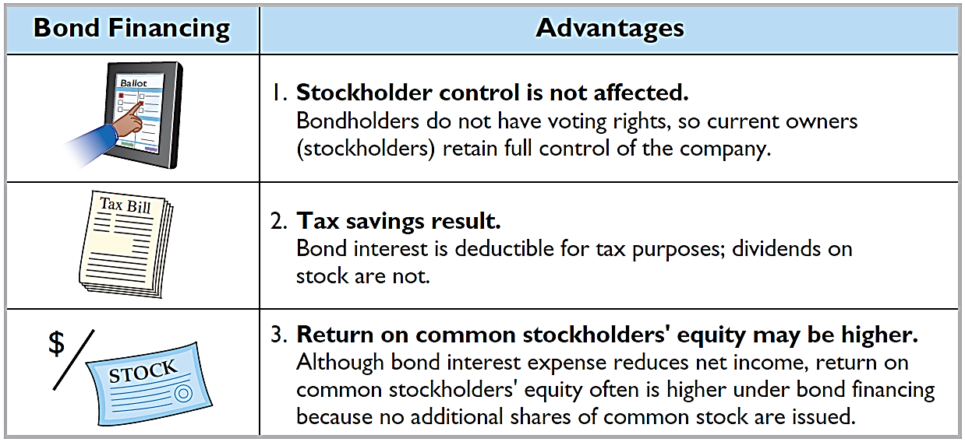
Debt and Equity Financing

Slide 74
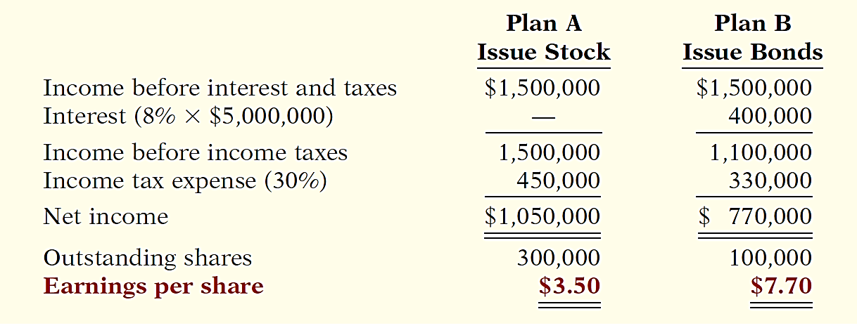
Debt and Equity Financing
Illustration: Microsystems, Inc. is considering two alternatives for raising an additional $5 million:
Plan A involves issuing 200,000 shares of common stock at the current market price of $25 per share.
Plan B involves issuing $5 million of 8% bonds at face value.
Income before interest and taxes will be $1.5 million; income taxes are expected to be 30%.
>
<

Slide 75
Learning Objective 11-4
Reporting and Analyzing
Stockholders’ Equity

Slide 76
Outline
Reporting stockholders’ equity
Retained earnings restrictions
Balance sheet presentation of stockholders’ equity
Analysis of stockholders’ equity

Slide 77
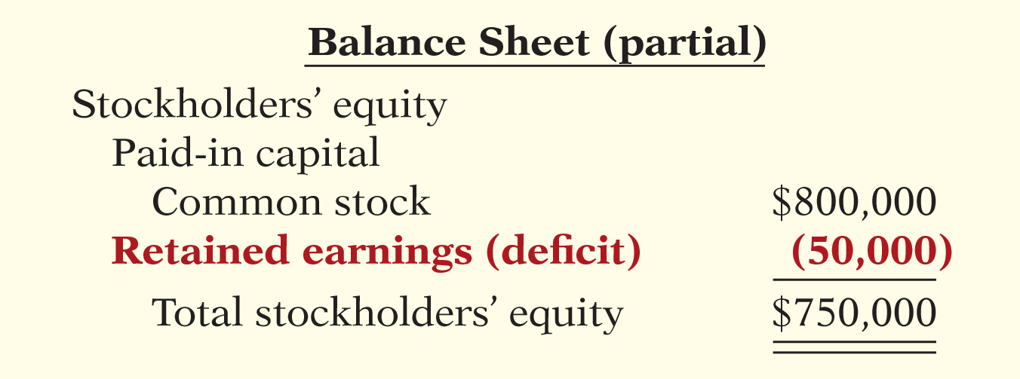
Reporting Stockholders’ Equity
Retained earnings is net income that a company retains in the business.
Part of the stockholders’ claim on the total assets of the corporation.

Slide 78
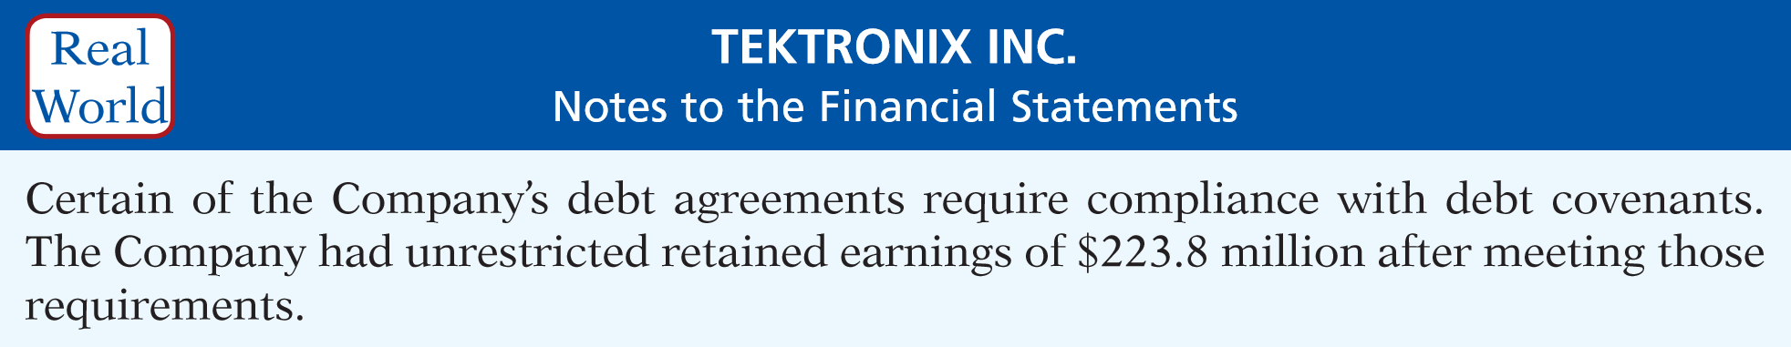
Retained Earnings Restrictions
Restrictions can result from:
Legal restrictions.
Contractual restrictions.
Voluntary restrictions.

Slide 79
Balance Sheet Presentation of SE
Companies report
paid-in capital,
Capital stock
Additional paid-in capital
retained earnings,
accumulated other comprehensive income, and
treasury stock.

Slide 80
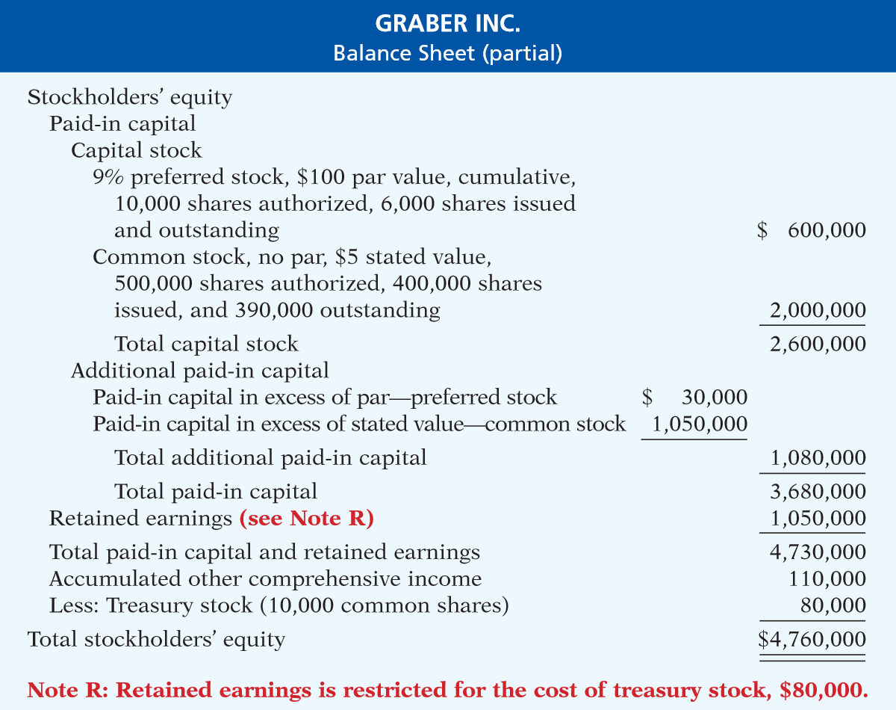
Balance Sheet Presentation of SE
Example

Slide 81
Analysis of Stockholders’ Equity
Payout Ratio
To illustrate, Nike’s dividends were recently $821 million and net income was $2,693 million.
The payout ratio measures the percentage of earnings a company distributes in the form of cash dividends to common stockholders.

Slide 82
Return On Common Stockholders’ Equity
To illustrate, Walt Disney Company’s beginning-of-the-year and end-of-the-year common stockholders’ equity were $31,820 and $30,753 million, respectively. Its net income was $4,687 million, and no preferred stock was outstanding.
Ratio shows how many dollars of net income the company earned for each dollar invested by the common stockholders.

